Slide 1
Industrial Relations
Dashboard for Disciplinary Case Management

Slide 2
Dashboard
Design Principles
Data Set
Walkthrough of Detail Functionality

Slide 3


Slide 4
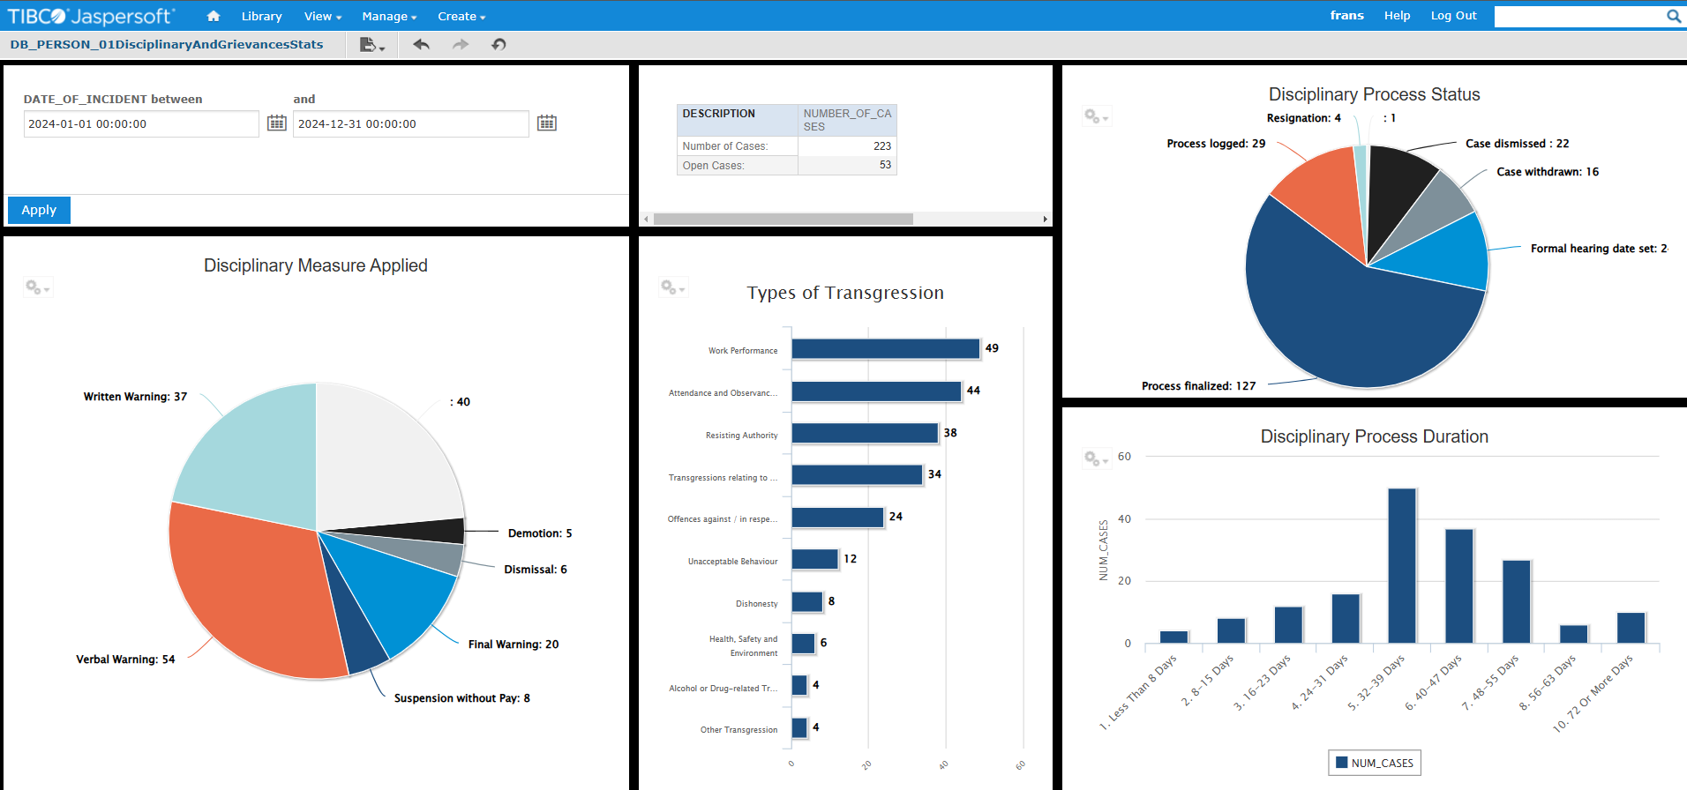

Slide 5


Slide 6
Design Principles
Minimum Viable Product: Disciplinary/Grievance Case Management
Minimum Data Entry
Easy Implementation
Controlled by IR
Rich Data Set

Slide 7


Slide 8
Disciplinary/Grievance Case Management: Data Set
Minimum Required Information
Additional Maintenance for Dashboard
Upload
of
Documents
Optional Supporting Information
Person involved
Date of Incident
Type of Incident / Transgression Code
Textual Description
Case Status
Disciplinary Measure Applied
Finalised Date
Chargesheet
DC Recordings / Transcripts / Minutes
Signed Employee Letters
Statements from Witnesses
Additional Case- and Outcome Info
Witnesses and Meetings
Formal Hearing and Committee
Appeal/Appeal Committee

Slide 9


Slide 10
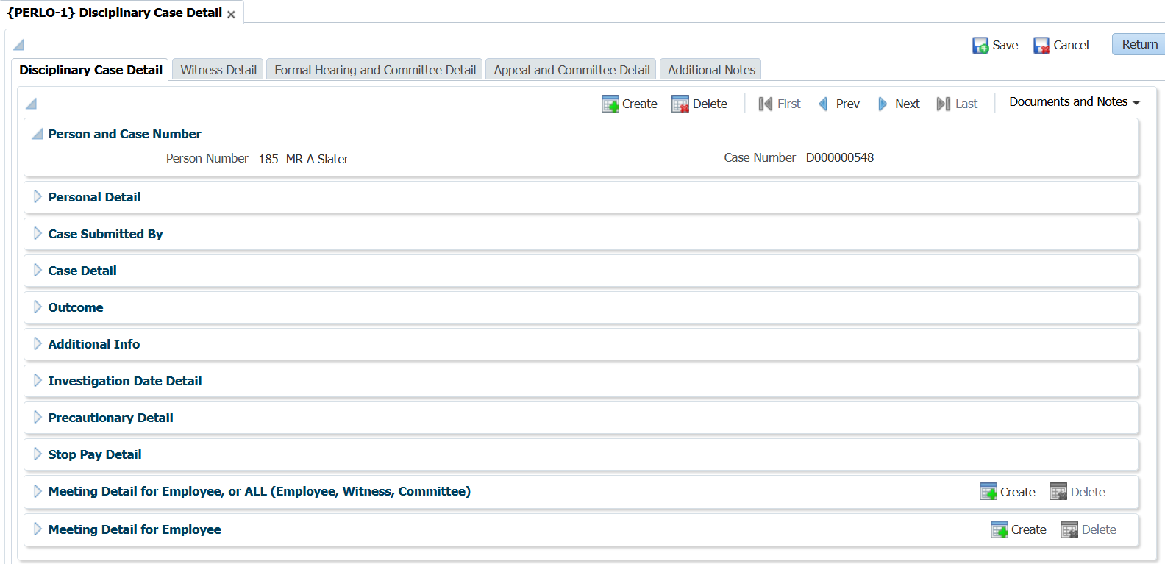
Walkthrough of Detail Functionality: Case Detail (1)

Slide 11
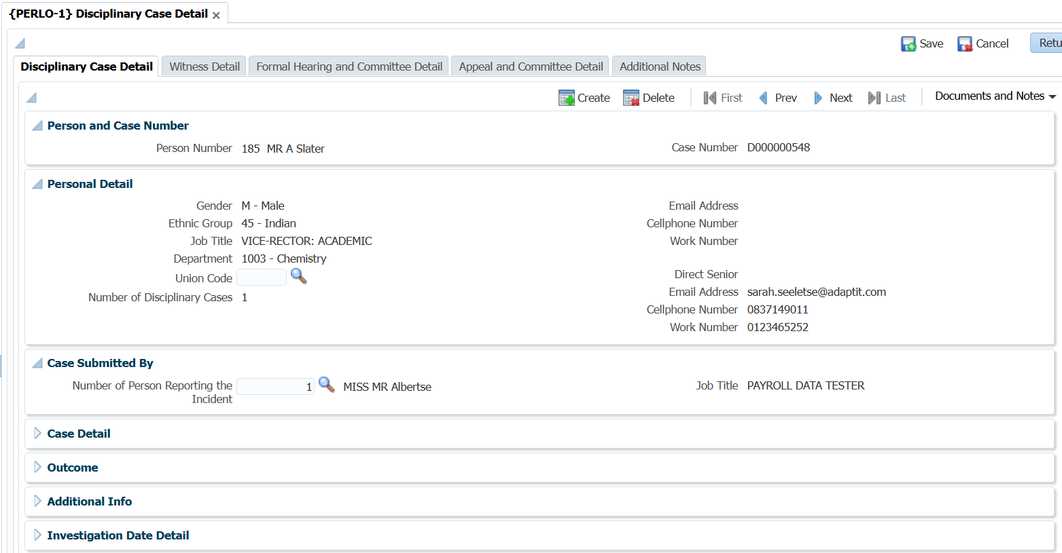
Walkthrough of Detail Functionality: Case Detail (2)

Slide 12
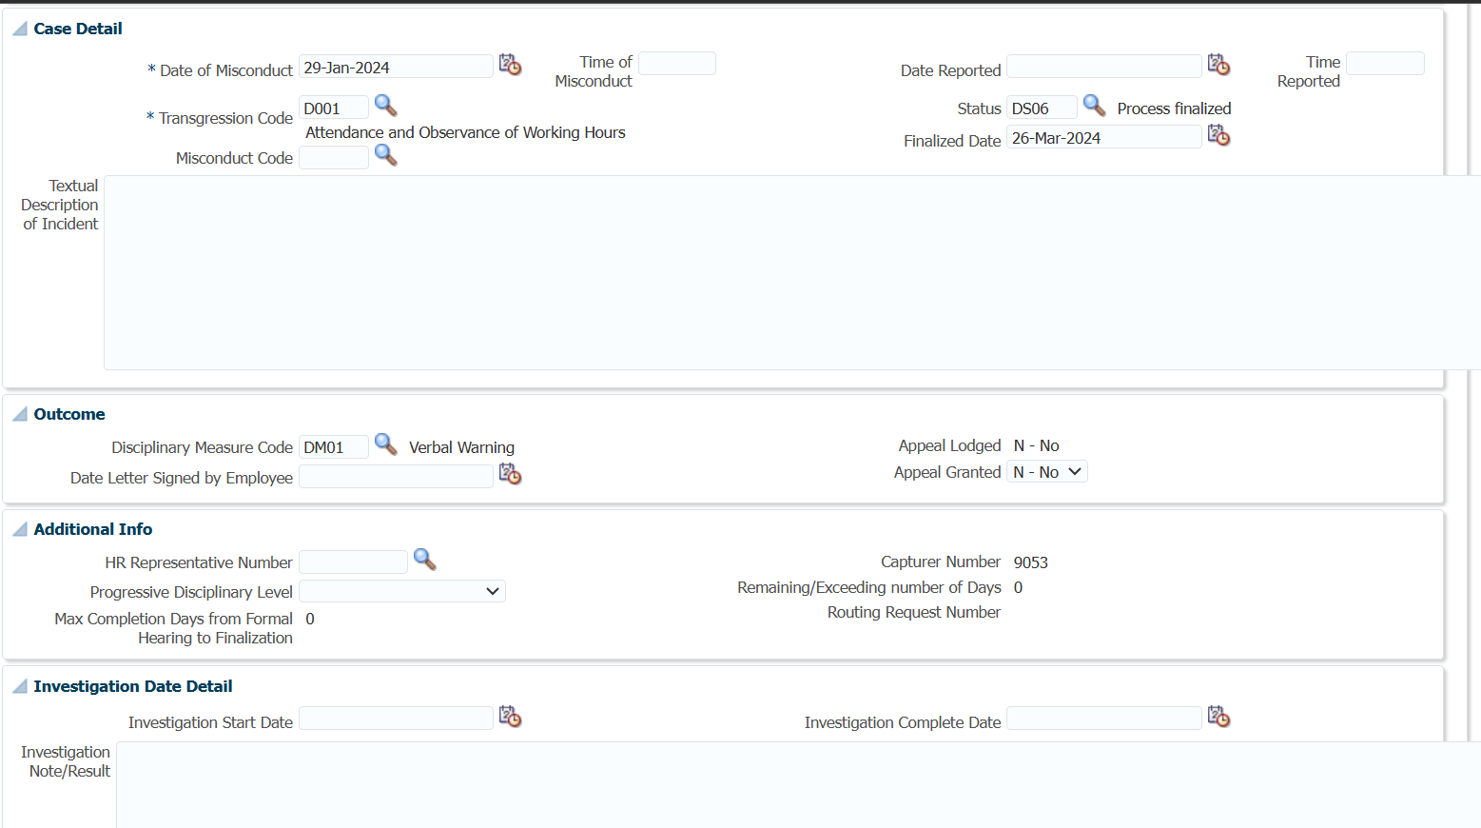
Walkthrough of Detail Functionality: Case Detail (3)

Slide 13
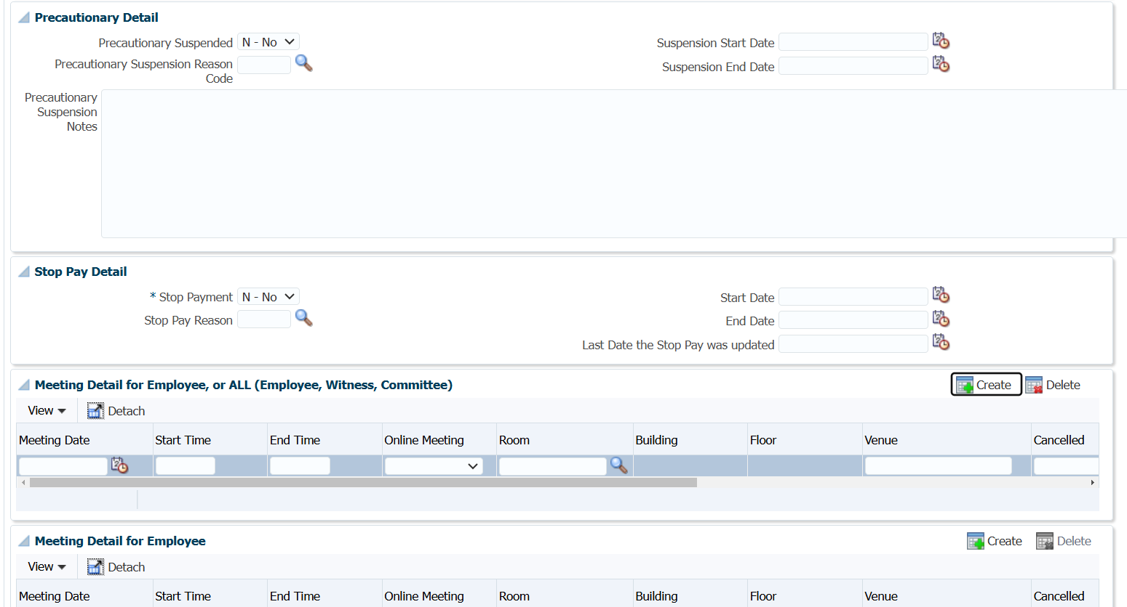
Walkthrough of Detail Functionality: Case Detail (4)

Slide 14
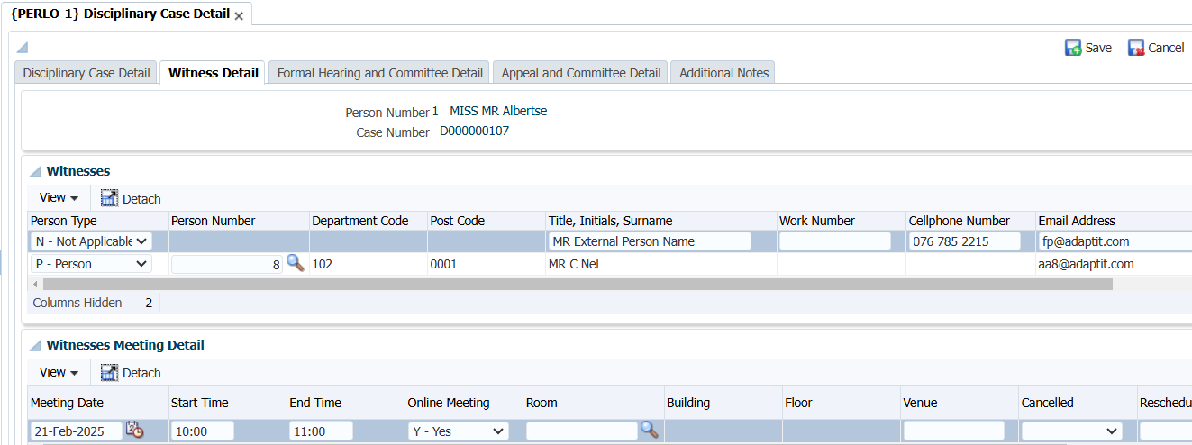
Walkthrough of Detail Functionality: Witness Detail

Slide 15
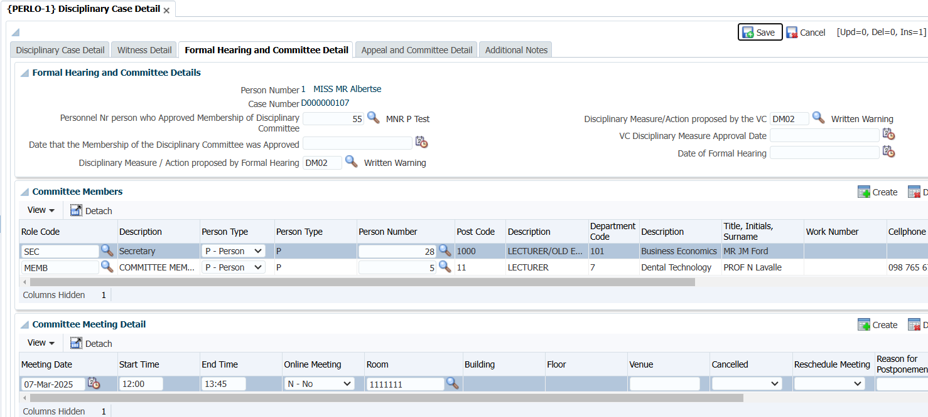
Walkthrough of Detail Functionality: Formal Hearing Detail

Slide 16
Walkthrough of Detail Functionality: Appeals

Slide 17
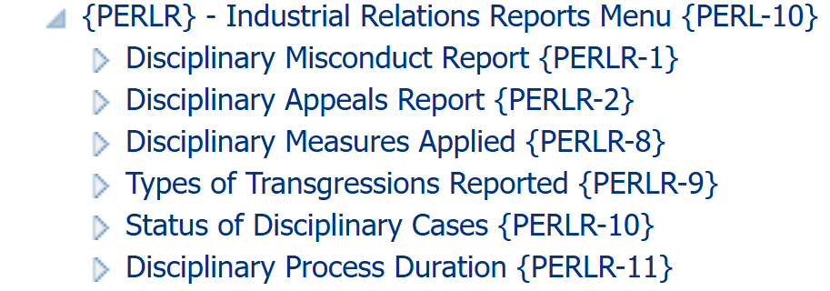
Walkthrough of Detail Functionality: Back-Office Reports

Slide 19
Case Management Solutions
Redevelop: New Module
Third Party Tool / Interface
Existing ITS Offering
Rudimentary
Record keeping
Limited implementation
Understand the requirements
Understand the appetite

Slide 20
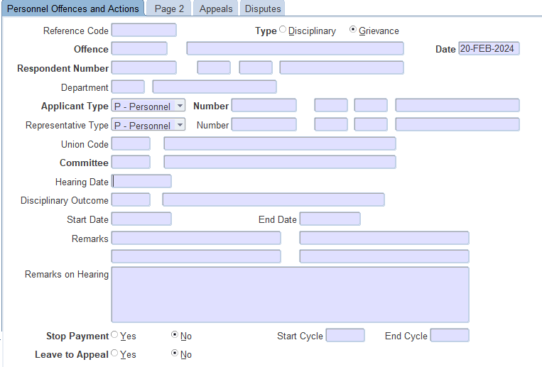
Existing ITS Offering
Advantages
  Information of Previous Cases available
  Detailed, secure recordkeeping
Disadvantages
  Labour intensive data capture by HR / IR Practitioners ?
  Limited set of data fields ?
  No workflow ?
Possibly not relevant to the work done by Industrial Relations practitioners ?

